Slide 1

Global Foods
website to showing world foods

Slide 2
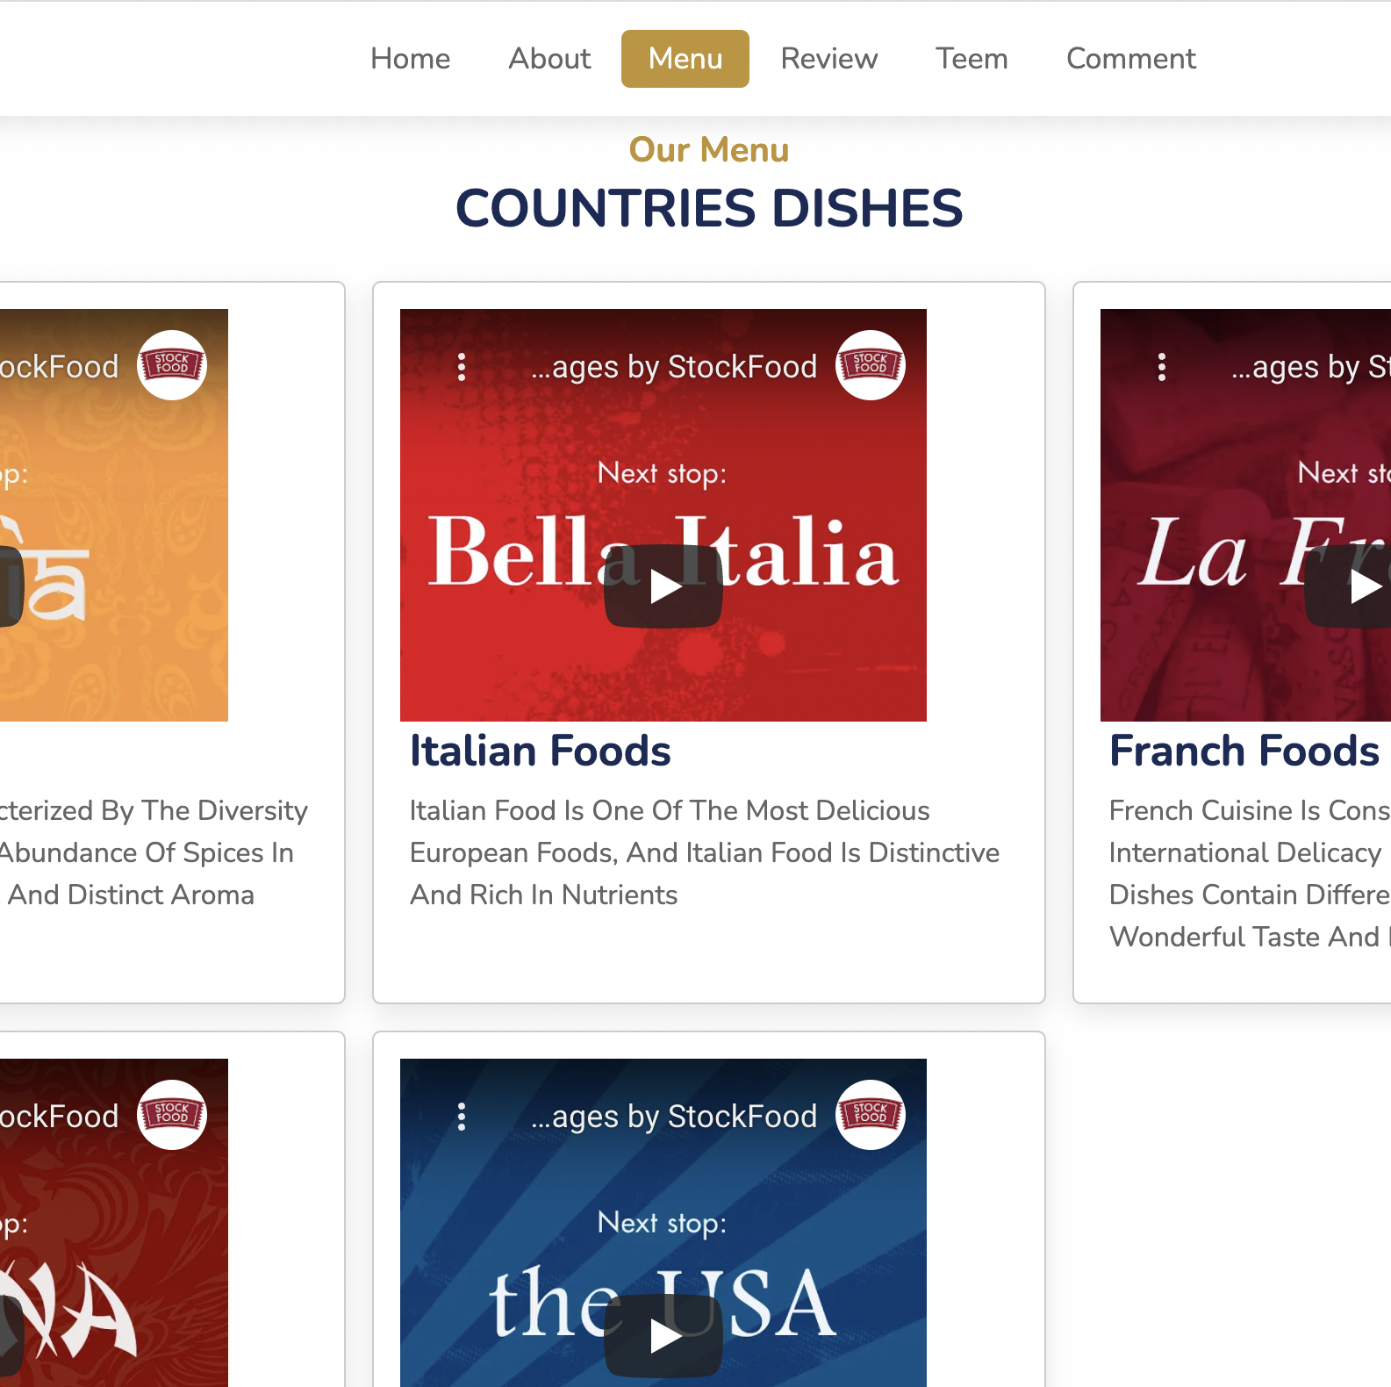
introduction
the world is characterized by different dishes, and each country has its own and unique dishes, so on this site we have collected some of the famous dishes of some countries and presented them in a distinctive , to make it easier for users to identify famous dishes in the world , and the website targets customers who prefer such dishes.

Slide 3

WEBSITE DESIGN
We used many programming language to design this website HTML , CSS , JAVASCRIPT , PHP

Slide 4

Site Map
Home
About
Menu
Review
Teem
Comment
All foods
Text Comment
Database

Slide 5
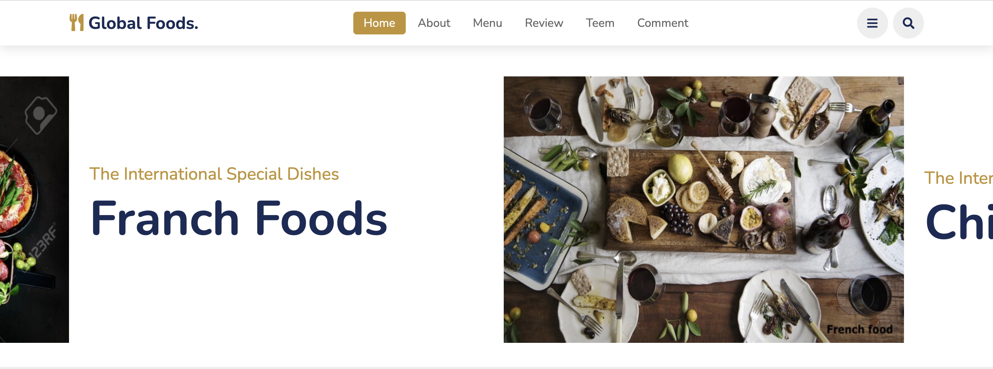
Home
This page displays everything the site has to offer in general.

Slide 6

About
The answer to this question is " why choose us? "

Slide 7
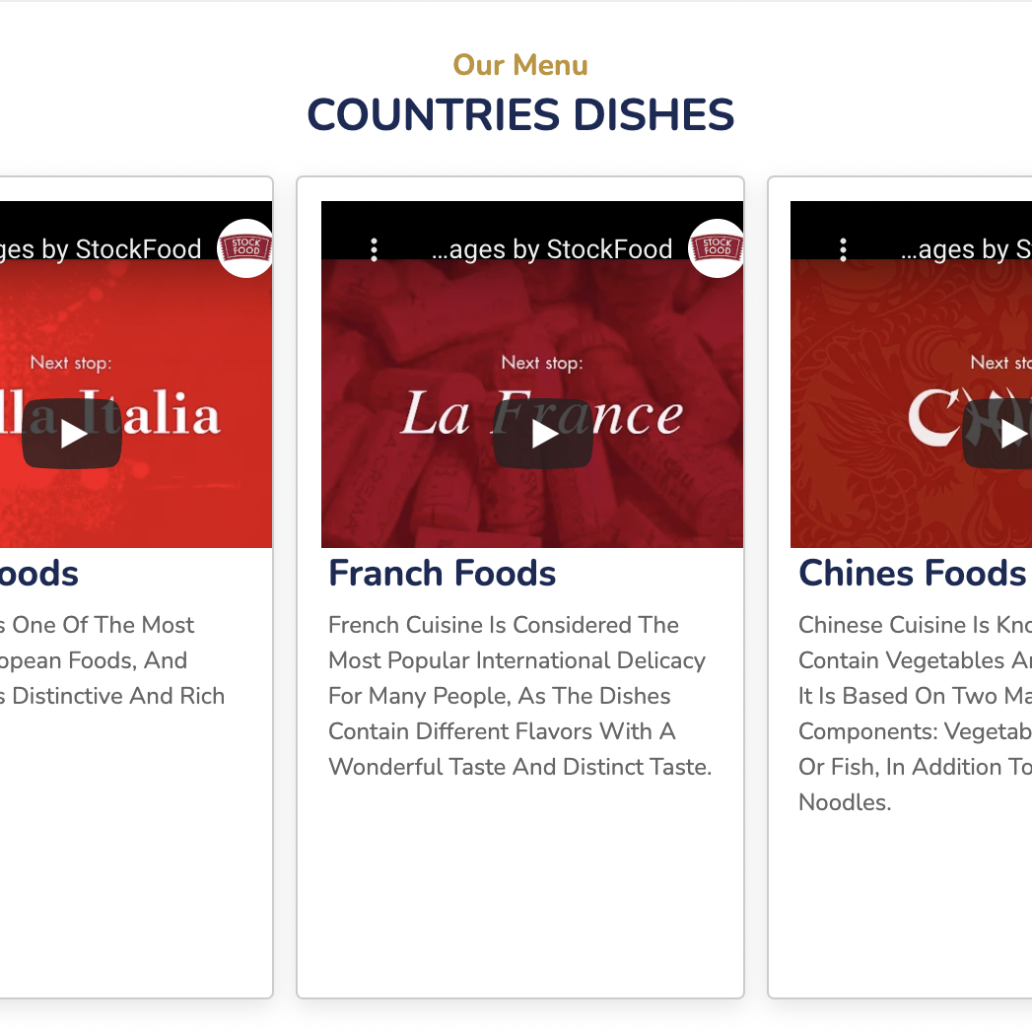
Menu
This page display all the international foods and information about each dish.

Slide 8
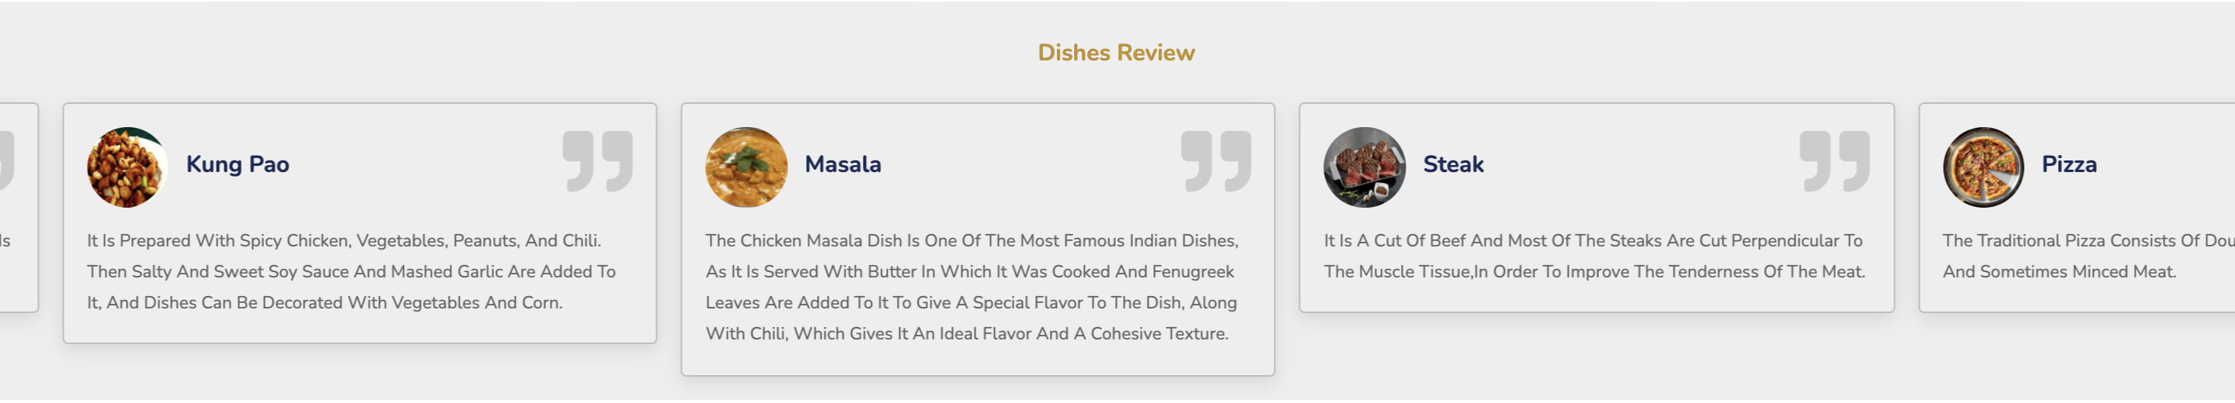
Review
This page review the dishes for each country.

Slide 9
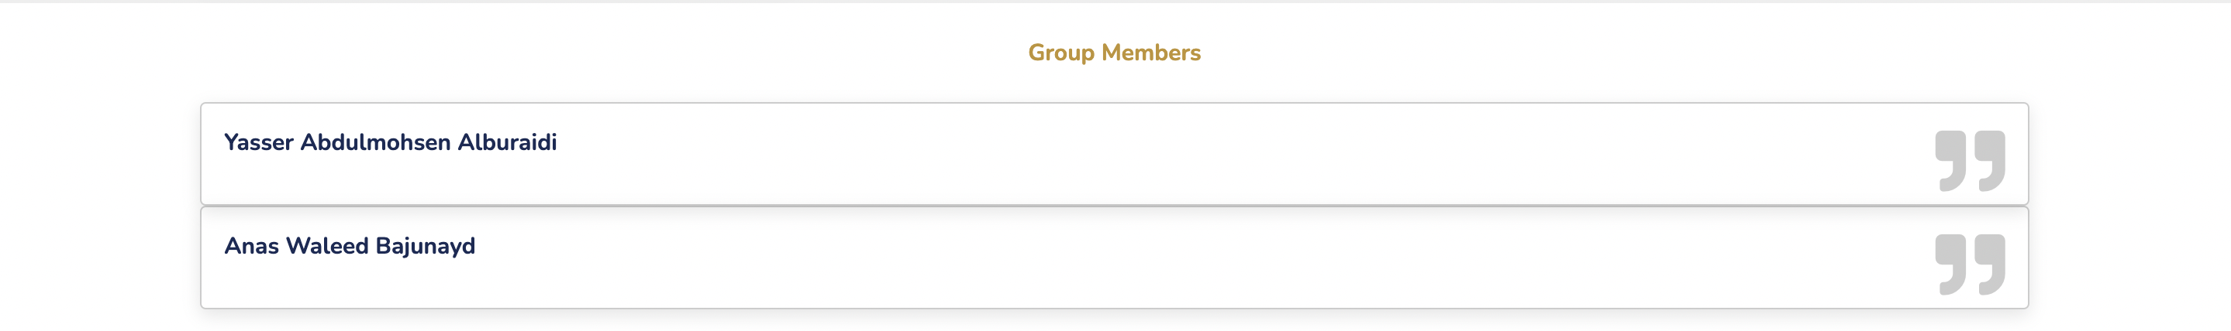
Teem
The group members who worked on this website.

Slide 10
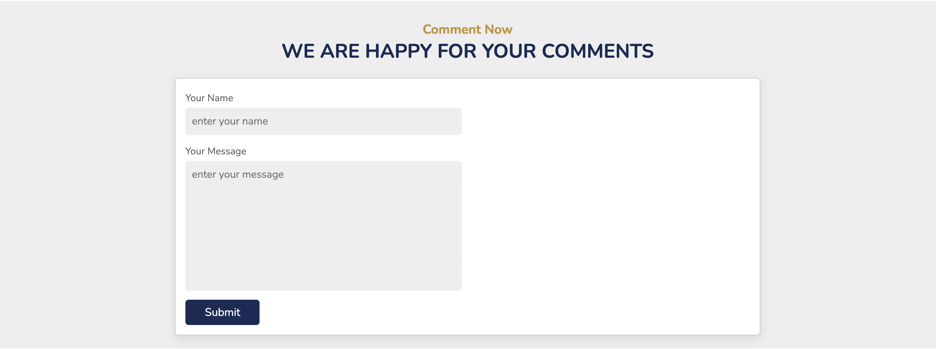
Comment
Here if the user want to write a comment.

Slide 11

footer
At the end of the site, there is quick access to pages and contact information.

Slide 12
Dynamic Components
Home page
Review page
Search

Slide 13

Business Logic
The structure of the database consists of a table of contents and contains columns and rows.
Through the HTML file, the user enters certain texts " comments ", which are the name, and message to be sent to the database.
Through the PHP file, we create a local host to connect the database with the HTML file and store the information entered on the server.

Slide 14

The group members
Yasser Abdalmohsen Alboraidi
Anas Waleed Bajunaud

